Slide 1
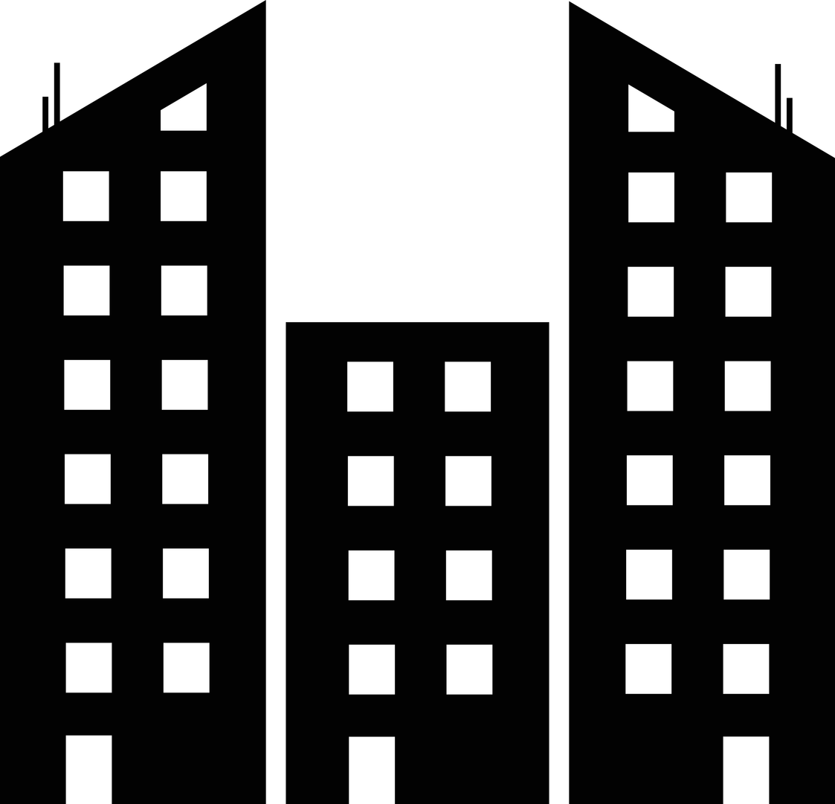




CS 440 (Group 4) - Design Project Part 1
SubterraView
SubterraView
MAPPING THE UNDERGROUND WORLD
Ashton Edakkunnathu, Jay Patel, Manan Patel,. Lena Tran
Notes:
Lena:
Hello everyone! Today we will be introducing you to SubterraView.

Slide 2
1
PROJECT BRIEF
2
Notes:
Lena:
To begin, we are going to explore what SubterraView actually is.

Slide 3
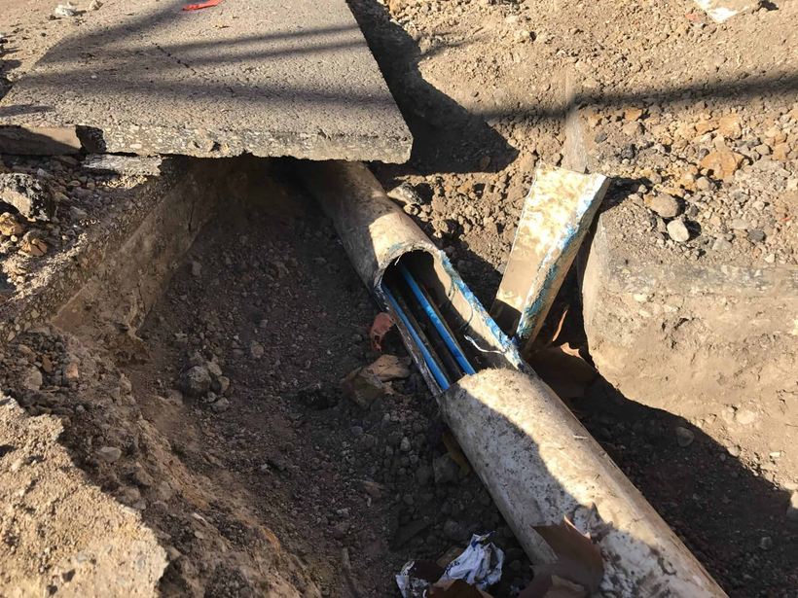
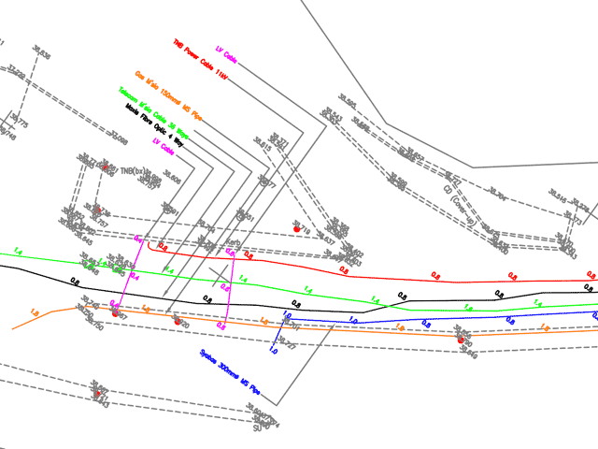
The Problem
197,000+ utility damage incidents recorded in 2024 alone [1]
Utility strikes cost the US an estimated $30 billion in societal costs annually [1]
73% of contractors report significant weaknesses in the 811 process [2]
3
Notes:
Lena:
Every year, construction crews strike underground utility lines that they are unaware of. This causes billions of dollars in damage and places workers' lives at risk.
The current solution is calling 811, a service that sends someone out to physically mark where lines are buried.
But with human capabilities and unexpected life events, this usually leads to the process being slow and the markings not being always accurate.
This system is unreliable, and that's exactly what SubterraView is trying to improve.

Slide 4
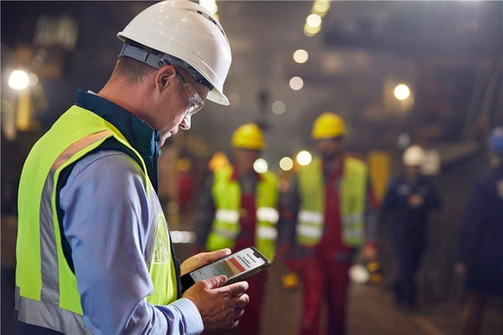
SubterraView Overview
Real-time AR map of underground infrastructure
accessible from any smartphone
AI engine validates and cross-references data for accuracy
Instant hazard alerts for gas leaks, structural instabilities, etc.
Field workers can report and update infrastructure directly from the field
4
Notes:
Lena -
SubterraView is an AR and AI powered smartphone app that gives construction workers, utility crews, and emergency responders a real-time visual of what's buried beneath their feet.
Instead of waiting days for 811 markings that may not even be accurate, workers can point their phone at the ground and instantly see verified utility lines.
An AI engine continuously cross-references data sources to make sure what they're seeing is accurate and up to date.
The system also sends real-time alerts for dangerous subsurface conditions like gas leaks, and field workers can report new findings or discrepancies directly from their phones, keeping the map up-to-date for everyone using it.

Slide 5



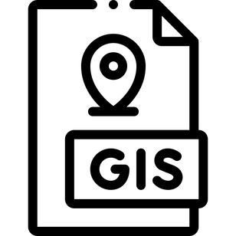

Technical Implementation
Architecture
AR Mapping
AI Engine
Cloud
Centralized backend
Mobile front end
APIs
GPS data + depth modeling
GIS
TensorFlow or PyTorch
Continuous learning pipelines
Technolgies
Senor Integration
AR frameworks
React Native
Cloud platforms
Database Systems
GraphQL for communications
IoT sensor units
LTE
Push notifications
5
Notes:
This slide explains the technical implementation of SubterraView.
It covers the technologies and system components needed to make our solution functional and reliable.
The system uses a cloud-based architecture, such as Azure or GCP, to store and process underground infrastructure data, making it easier to maintain across users.
A centralized backend handles AI processing, validation, and authentication.
A mobile front-end application allows field workers to interact with the system.
APIs connect our platform to external databases like city infrastructure and utility company records.
AR frameworks, like ARCore or ARKit, are used to create the underground visualization experience.
React Native allows cross-platform mobile development.
Cloud platforms host system services and store infrastructure data.
Database systems store infrastructure records and crowdsourced reports.
GraphQL or similar communication tools transfer data efficiently between system components.
AR mapping combines GPS data with depth modeling.
GIS technology aligns infrastructure data with real-world locations.
Users can visually see underground utilities through their smartphone camera.
IoT sensor units detect hazards like gas leaks or structural instability.
Sensors communicate through LTE or wireless networks.
The system sends push notifications and displays real-time hazard alerts in AR.
AI frameworks like TensorFlow or PyTorch validate infrastructure data.
AI cross-references multiple data sources and assigns confidence scores.
Continuous learning allows the system to improve accuracy over time.
This combination of cloud computing, AR visualization, AI validation, and sensor monitoring creates a scalable and safety-focused underground mapping system.

Slide 6
2
STAKEHOLDERS & GOALS
6
Notes:
Let's learn about our stakeholders & goals

Slide 7

SubterraView Goals
≥ 30% reduction in accidental utility strikes vs. national average
Pre-excavation prep time cut to 24 hours or less
AI map accuracy of ≥ 90% against verified utility records
≥ 85% of hazard alerts acknowledged and acted on within 5 minutes of detection
7
Notes:
Lena:
First, we want at least a 30 percent reduction in accidental utility strikes among users compared to the national average.
Along with that, the time for pre-excavation preperation is reduced from several days to 24 hours or less. This in itself directly impacts project costs and timelines.
The AI map needs to hit 90 percent accuracy against verified utility records, because if workers can't trust what they're seeing, they won't use it.
And fourth, at least 85 percent of hazard alerts need to be acknowledged and acted on within 5 minutes of detection.
We're using response rate as our measure here because tracking long-term injury reduction takes years of data, but how quickly workers respond to alerts tells us right away whether the system is actually keeping people safe.

Slide 8
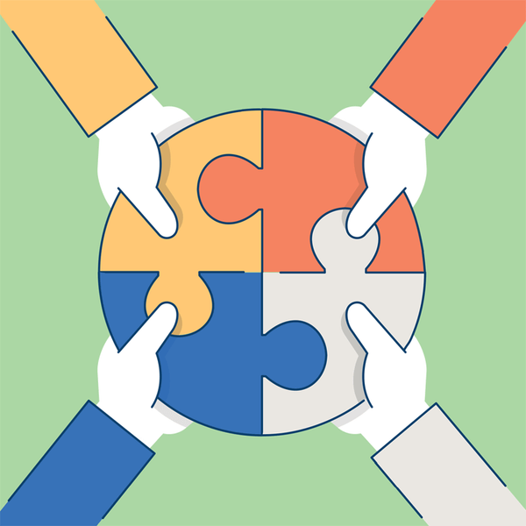
Stakeholders
Primary Client: Public Works Organizations
Customers/End Users: Construction companies, utility workers, emergency responders, townspeople, maintenance users
8
Notes:
When talking about stakeholders, SubterraView will have a big range. Our primary clients are public works organizations that purchase and deploy the app. The end users include construction companies, utility field workers, and public works crews who use SubterraView on their devices in the field daily. Beyond these core groups, there can be others like: emergency responders or regular individuals who might want to use SubterraView for backyard projects like installing a pool or planting trees.

Slide 9
3
SCOPE OF WORK & PRODUCT
9
Notes:
Now lets take a look at the scope.

Slide 10
Scope of the Work
Business Environment: Underground infrastructure management
Who’s involved: Construction crews, utility companies, 811 services, city agencies, emergency responders
Current Workflow: 811 ticket → utility markings → crews excavate
Core Pain Points: Delays, fragmented records, conflicing sources, safety risks & utility strikes
10
Notes:
For scope of the work, we're describing the business environment our product lives in, not the product itself. SubterraView operates in underground infrastructure management and worker safety coordination. Today the workflow is usually something involving the crew submitting an 811 request, utilities respond and mark the ground, and crews rely on surface paint and static records while excavating. The problem is this process is slow and fragmented, data can be outdated or inconsistent which causes delays and increases the risk of striking utilities or missing hazards. So the work we focus on is the process of locating, validating, and monitoring underground utility information.

Slide 11

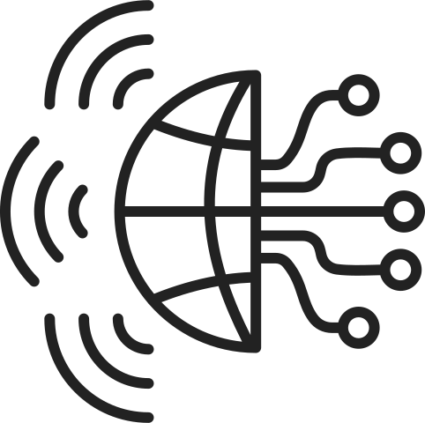
Scope of the Product
Emergency Responder
SubterraView
View Underground Infrastructure
Construction Worker
Validate Utility Records
City Infrastructure Database
Receive Hazard Alerts
Utility Technician
Access Emergency Mode
Utility Database
Review Data Accuracy Reports
Crowdsourced Infrastructure Report
System Administrator
Hazard Sensor Network
11
Notes:
This is the scenario diagram for SubterraView. On the left we have our primary human users. Construction workers use the AR map before and during excavation and can also submit field reports. Field workers do the same from a utility and maintenance perspective. System administrators oversee data accuracy reviews. On the right are the external systems the platform depends on. This includes the utility database, city infrastructure records, and the hazard sensor network that feeds real time alerts into the app. Emergency responders are also on the right since they access the system during incidents. Next we'll walk through a scenario involving a construction worker to show how it all comes together in practice.

Slide 12
Example Scenario: Construction Worker
Construction worker Carlos Mendez arrives at a downtown excavation site to begin digging for a new water line installation
Before starting, he opens SubterraView on his smartphone and selects the project location
The system overlays underground infrastructure onto his camera view, showing gas lines, electrical conduits, and telecom cables beneath the surface
Carlos notices a gas line running closer to the excavation area than expected and adjust the dig plan accordingly
During excavation, a gas sensor detects abnormal methane levels, SubterraView sends a hazard alert and Carlos pauses his work and contacts emergency responders
12
Notes:
In this scenario, a construction worker uses SubterraView before excavation begins. Instead of relying solely on 811 markings, he visualizes underground utilities directly through AR. The system helps him adjust the excavation plan to avoid damage. When a hazard is detected, the app immediately alerts him and provides responders with accurate underground mapping. This scenario shows how the product improves safety and efficiency in real-world use.

Slide 13


Our Competition
Group 4
13
Notes:
As for our competition, there are existing solutions such as vGIS and 811 services, but neither provides a complete solution. vGIS focuses primarily on AR visualization using existing BIM and GIS data, but it relies on external records and does not include built-in AI validation, crowdsourced updated, and hazard alerts. As for 811 services, the process is manual and time consuming with no digital AR interface. SubterraView differentiates itself by combining AR visualization, crowdsourced reporting, and an active hazard monitoring system into a single platform.

Slide 14
4
CONSTRAINTS & ASSUMPTIONS
14

Slide 15
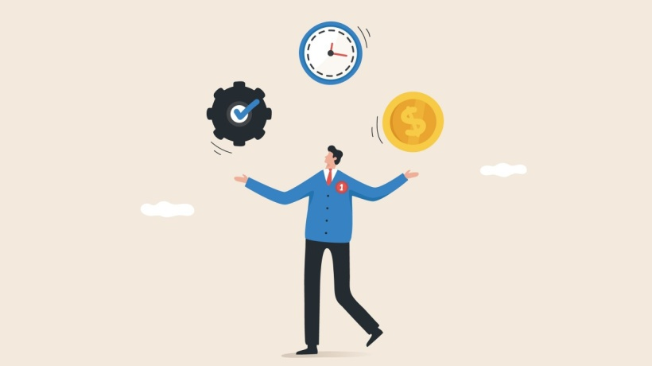
Group 4
Constraints
Conformance for 811
Date Accuracy
Compatiblity + Hardware
15
Notes:
The primary constraint is that SubterraView cannot legally replace mandatory call requests. So to some extent SubterraView must operate as a supplementary tool that enhances efficiency and safety while still requiring to follow excavation laws.
Even with AI validation, SubterraView cannot guarantee complete accuracy because municipal records are often outdated or incomplete. Our AI can only enhance and validate existing data.
SubterraView must be compatible with iOS and Android smartphones equipped with GPS and camera capabilities. Additionally, the app requires hazard detection sensors, which may need external hardware integration since most consumer smartphones do not have built-in hazard detection capabilities.

Slide 16

Group 4
Assumptions
Users will receive training
Reliable internet connectivity
Utility companies will allow data access
Infrastructure repair and regulatory compliance
16
Notes:
We assume users such as construction workers and emergency responders will receive training.
This training ensures they understand how to use AR visualization, hazard alerts, and reporting tools safely and effectively.
The system assumes reliable internet access during normal operation.
Internet connectivity allows real-time infrastructure updates, hazard alerts, and data synchronization.
We assume utility companies and municipal agencies will allow access to infrastructure data.
This data is critical for maintaining accurate underground mapping and validation.
Infrastructure repair, maintenance, and regulatory compliance remain the responsibility of outside organizations.
SubterraView is designed to support planning, visualization, and safety, not physical infrastructure work.

Slide 17
References
[1] Common Ground Alliance, "2024 DIRT Report: Damage Information Reporting Tool," Common Ground Alliance, Washington, DC, 2025.
[2] Associated General Contractors of America, "Most Contractors Report Significant Flaws With The Nation's 811 Utility Location System, Citing Inaccurate Locates And Slow Response Times," Associated General Contractors of America, Arlington, VA, Nov. 2021.
17
Notes:
These are our references.

Slide 18
Thank You
FOR LISTENING =)

